Slide 1
Паттерны проектирования
Фабричный метод

Slide 2
Определение изменяемых аспектов
Pizza orderPizza(String type){ Pizza pizza; if (type.equals("cheese")){ pizza = new CheesePizza(); } else if (type.equals("greek")){ pizza = new GreekPizza(); } else if (type.equals("pepperoni")){ pizza = new PepperoniPizza(); } pizza.prepare(); pizza.bake(); pizza.cut(); pizza.box(); return pizza; }

Slide 3
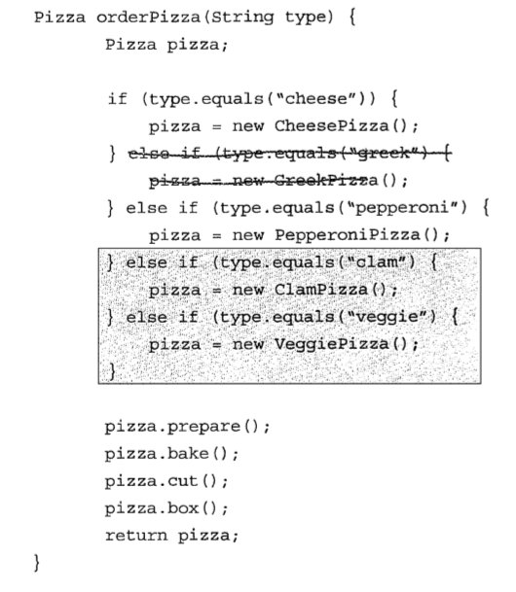
Добавление новых типов пиццы

Slide 4
Инкапсуляция создания объектов
public class SimplePizzaFactory { public Pizza createPizza(String type){ Pizza pizza = null; if (type.equals("cheese")){ pizza = new CheesePizza(); } else if (type.equals("clam")){ pizza = new ClamPizza(); } else if (type.equals("pepperoni")){ pizza = new PepperonyPizza(); } return pizza; } }
public class PizzaStore { SimplePizzaFactory factory; public PizzaStore(SimplePizzaFactory factory){ this.factory = factory; } Pizza orderPizza(String type){ Pizza pizza; pizza = factory.createPizza(type); pizza.prepare(); pizza.bake(); pizza.cut(); pizza.box(); return pizza; } }

Slide 5
Классы пиццы
public abstract class Pizza { public abstract void prepare(); public abstract void bake(); public abstract void cut(); public abstract void box(); }
public class CheesePizza extends Pizza { public void prepare(){System.out.println("Preparing CHEESE pizza");} public void bake(){System.out.println("Baking CHEESE pizza");} public void cut(){System.out.println("Cutting CHEESE pizza");} public void box(){System.out.println("Boxing CHEESE pizza");} }
public class PepperonyPizza extends Pizza { public void prepare(){System.out.println("Preparing PEPPERONI pizza");} public void bake(){System.out.println("Baking PEPPERONI pizza");} public void cut(){System.out.println("Cutting PEPPERONI pizza");} public void box(){System.out.println("Boxing PEPPERONI pizza");} }

Slide 6
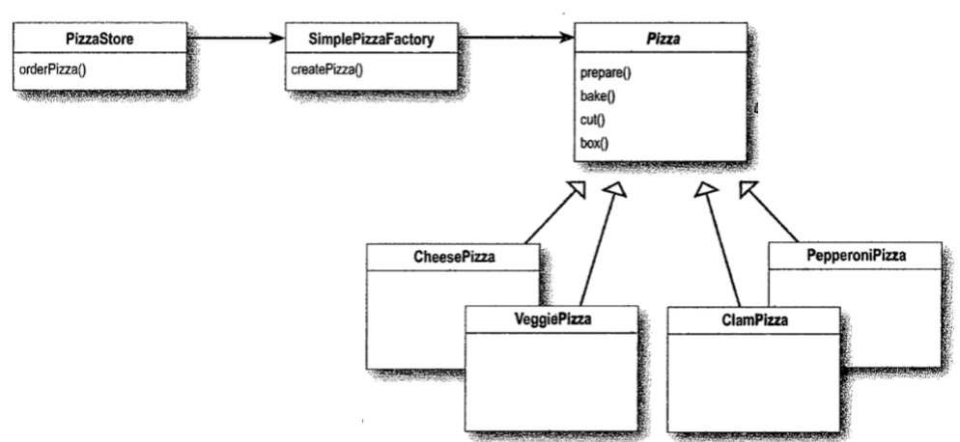
Простая фабрика

Slide 7
Работа программы
Preparing CHEESE pizza
Baking CHEESE pizza
Cutting CHEESE pizza
Boxing CHEESE pizza
____________________________
Preparing PEPPERONI pizza
Baking PEPPERONI pizza
Cutting PEPPERONI pizza
Boxing PEPPERONI pizza
public class Solution { public static void main(String[] args) { SimplePizzaFactory factory = new SimplePizzaFactory(); PizzaStore pizzaStore = new PizzaStore(factory); pizzaStore.orderPizza("cheese"); System.out.println("____________________________"); pizzaStore.orderPizza("pepperoni"); } }

Slide 8
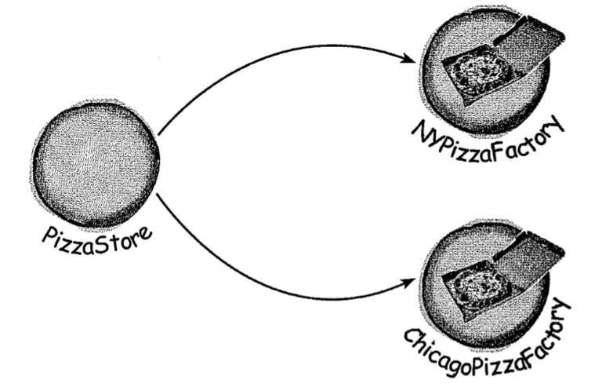
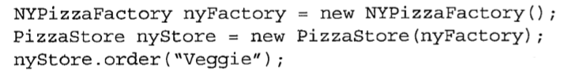
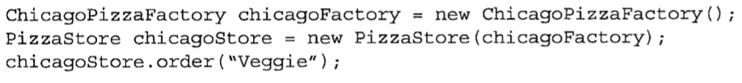
Расширение бизнеса

Slide 9
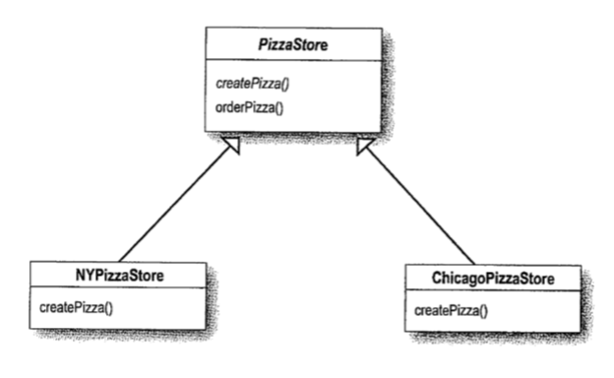
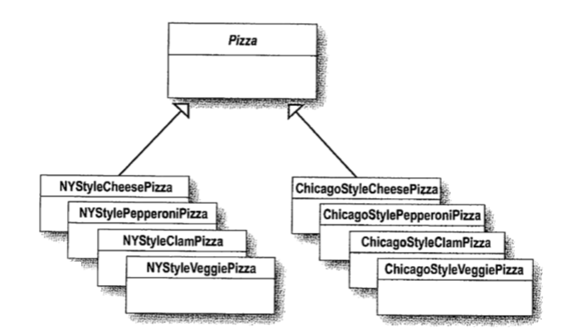
Классы-создатели Классы-продукты

Slide 10
Пицца
public abstract class Pizza { String name; String dough; String sauce; ArrayList toppings = new ArrayList(); public String getName() { return name; } public void prepare(){ System.out.println("Preparing " + name); System.out.println("Tossing dough..."); System.out.println("Adding sauce..."); System.out.println("Adding toppings: "); for (int i = 0; i < toppings.size(); i++){ System.out.println(" " + toppings.get(i)); } } void bake(){ System.out.println("Bake for 20 minutes"); } void cut(){ System.out.println("Cutting"); } void box(){ System.out.println("Place to box"); } }
public class NYStyleCheesePizza extends Pizza { public NYStyleCheesePizza(){ name = "NY Style Sauce and Cheese Pizza"; dough = "Thin Crust Dough"; sauce = "Marinara Sauce"; toppings.add("Grated Reggiano Cheese"); } }
public class NYStyleClamPizza extends Pizza { public NYStyleClamPizza(){ name = "NY Style Sauce and Clam Pizza"; dough = "Thin Crust Dough"; sauce = "Marinara Sauce"; toppings.add("Clams"); } }
public class ChicagoStyleCheesePizza extends Pizza { public ChicagoStyleCheesePizza(){ name = "Chicago Style Deep Dish Cheese Pizza"; dough = "Extra Thick Crust Dough"; sauce = "Marinara Sauce"; toppings.add("Shredded Mozzarella Cheese"); } void cut(){ System.out.println("Cutting the pizza into square slices"); } }

Slide 11
Локализация операций по изготовлению пиццы
public class NYStylePizzaStore extends PizzaStore { public Pizza createPizza(String type){ Pizza pizza = null; if (type.equals("cheese")){ pizza = new NYStyleCheesePizza(); } else if (type.equals("clam")){ pizza = new NYStyleClamPizza(); } else if (type.equals("pepperoni")){ pizza = new NYStylePepperoniPizza(); } return pizza; } }
public abstract class PizzaStore { public Pizza orderPizza(String type){ Pizza pizza; pizza = createPizza(type); pizza.prepare(); pizza.bake(); pizza.cut(); pizza.box(); return pizza; } protected abstract Pizza createPizza(String type); }
public class ChicagoStylePizzaStore extends PizzaStore{ public Pizza createPizza(String type){ Pizza pizza = null; if (type.equals("cheese")){ pizza = new ChicagoStyleCheesePizza(); } else if (type.equals("clam")){ pizza = new ChicagoStyleClamPizza(); } else if (type.equals("pepperoni")){ pizza = new ChicagoStylePepperoniPizza(); } return pizza; } }

Slide 12
Тестирование
public class PizzaTestDrive { public static void main(String[] args) { PizzaStore nyStore = new NYStylePizzaStore(); PizzaStore chicagoStore = new ChicagoStylePizzaStore(); Pizza pizza = nyStore.orderPizza("cheese"); System.out.println("Odered a " + pizza.getName() + "\n"); pizza = chicagoStore.orderPizza("cheese"); System.out.println("Ordered a " + pizza.getName() + "\n"); } }
Preparing NY Style Sauce and Cheese Pizza
Tossing dough...
Adding sauce...
Adding toppings:
Grated Reggiano Cheese
Bake for 20 minutes
Cutting
Place to box
Odered a NY Style Sauce and Cheese Pizza
Preparing Chicago Style Deep Dish Cheese Pizza
Tossing dough...
Adding sauce...
Adding toppings:
Shredded Mozzarella Cheese
Bake for 20 minutes
Cutting the pizza into square slices
Place to box
Ordered a Chicago Style Deep Dish Cheese Pizza

Slide 13
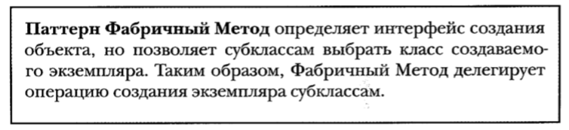
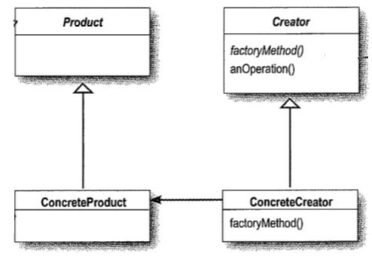

Slide 14
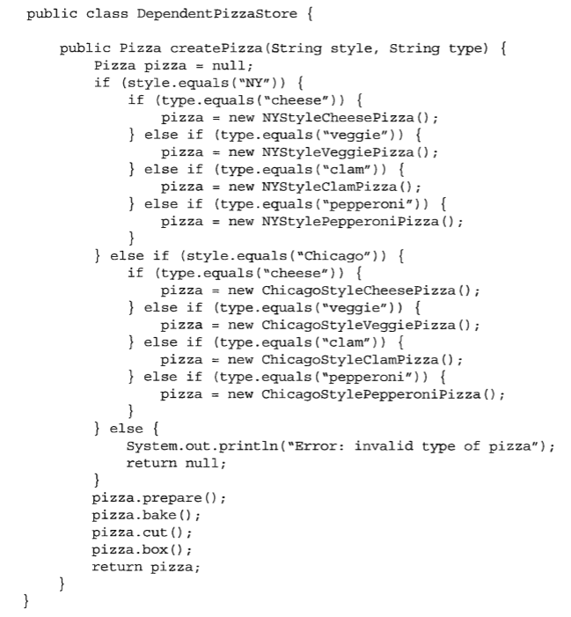

Slide 15
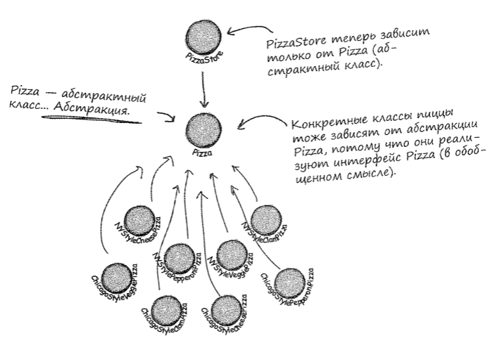
Принцип инверсии зависимостей

Slide 16
Абстрактная фабрика

Slide 17
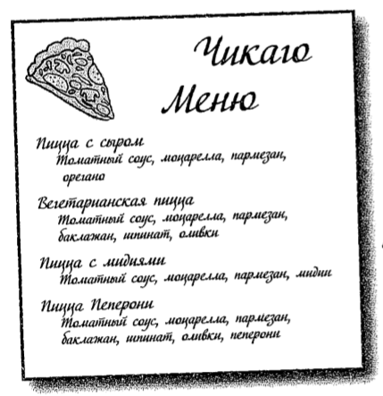
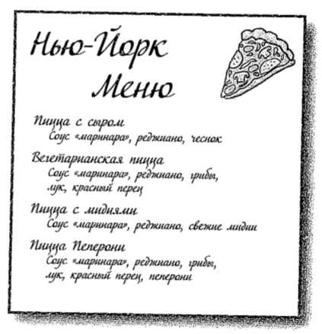
Различные наборы ингредиентов
Пиццы делаются из одних компонентов, но в разных регионах используются разные реализации этих компонентов

Slide 18
Фабрики ингредиентов
public interface PizzaIngredientFactory { public Dough createDough(); public Sauce createSauce(); public Cheese createCheese(); public Pepperoni createPepperoni(); public Clams createClam(); }
public class NYPizzaIngredientFactory implements PizzaIngredientFactory { public Dough createDough(){ return new ThinCrustDough(); } public Sauce createSauce(){ return new MarinaraSauce(); } public Cheese createCheese(){ return new ReggianoCheese(); } public Pepperoni createPepperoni(){ return new SlicedPepperoni(); } public Clams createClam(){ return new FreshClams(); } }
public class ChicagoPizzaIngredientFactory implements PizzaIngredientFactory { public Dough createDough(){ return new ThinCrustDough(); } public Sauce createSauce(){ return new MarinaraSauce(); } public Cheese createCheese(){ return new Mozzarella(); } public Pepperoni createPepperoni(){ return new SlicedPepperoni(); } public Clams createClam(){ return new FrosenClams(); } }

Slide 19
Классы пиццы
public class CheesePizza extends Pizza { PizzaIngredientFactory ingredientFactory; public CheesePizza(PizzaIngredientFactory ingredientFactory){ this.ingredientFactory = ingredientFactory; } void prepare(){ System.out.println("Preparing " + name); dough = ingredientFactory.createDough(); sauce = ingredientFactory.createSauce(); cheese = ingredientFactory.createCheese(); } }
public abstract class Pizza { String name; Dough dough; Sauce sauce; Cheese cheese; Pepperoni pepperoni; Clams clam; public String getName() { return name; } public void setName(String name) { this.name = name; } abstract void prepare(); void bake() { System.out.println("Bake for 25 minutes at 350"); } void cut(){ System.out.println("Cutting the pizza into diagonal slices"); } void box(){ System.out.println("Place pizza in offitial PizzaStore box"); } }
public class ClamPizza extends Pizza { PizzaIngredientFactory ingredientFactory; public ClamPizza(PizzaIngredientFactory ingredientFactory){ this.ingredientFactory = ingredientFactory; } void prepare(){ System.out.println("Preparing " + name); dough = ingredientFactory.createDough(); sauce = ingredientFactory.createSauce(); cheese = ingredientFactory.createCheese(); clam = ingredientFactory.createClam(); } }

Slide 20
Пиццерии
public class NYPizzaStore extends PizzaStore { protected Pizza createPizza(String item){ Pizza pizza = null; PizzaIngredientFactory ingredientFactory = new NYPizzaIngredientFactory(); if(item.equals("cheese")){ pizza = new CheesePizza(ingredientFactory); pizza.setName("NY Style Cheese Pizza"); } else if (item.equals("clam")){ pizza = new ClamPizza(ingredientFactory); pizza.setName("NY Style Clam Pizza"); } return pizza; } }
public class ChicagoPizzaStore extends PizzaStore { protected Pizza createPizza(String item){ Pizza pizza = null; PizzaIngredientFactory ingredientFactory = new ChicagoPizzaIngredientFactory(); if(item.equals("cheese")){ pizza = new CheesePizza(ingredientFactory); pizza.setName("Chicago Style Cheese Pizza"); } else if (item.equals("clam")){ pizza = new ClamPizza(ingredientFactory); pizza.setName("Chicago Style Clam Pizza"); } return pizza; } }

Slide 21
Тестирование
public class Solution { public static void main(String[] args) {
PizzaStore nyPizzaStore = new NYPizzaStore(); nyPizzaStore.orderPizza("cheese");
PizzaStore chicagoPizzaStore = new ChicagoPizzaStore(); chicagoPizzaStore.orderPizza("cheese");
} }
Preparing NY Style Cheese Pizza
Bake for 25 minutes at 350
Cutting the pizza into diagonal slices
Place pizza in offitial PizzaStore box
Preparing Chicago Style Cheese Pizza
Bake for 25 minutes at 350
Cutting the pizza into diagonal slices
Place pizza in offitial PizzaStore box

Slide 22
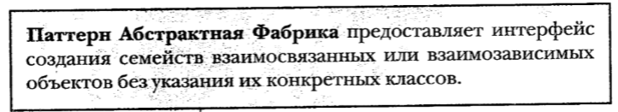
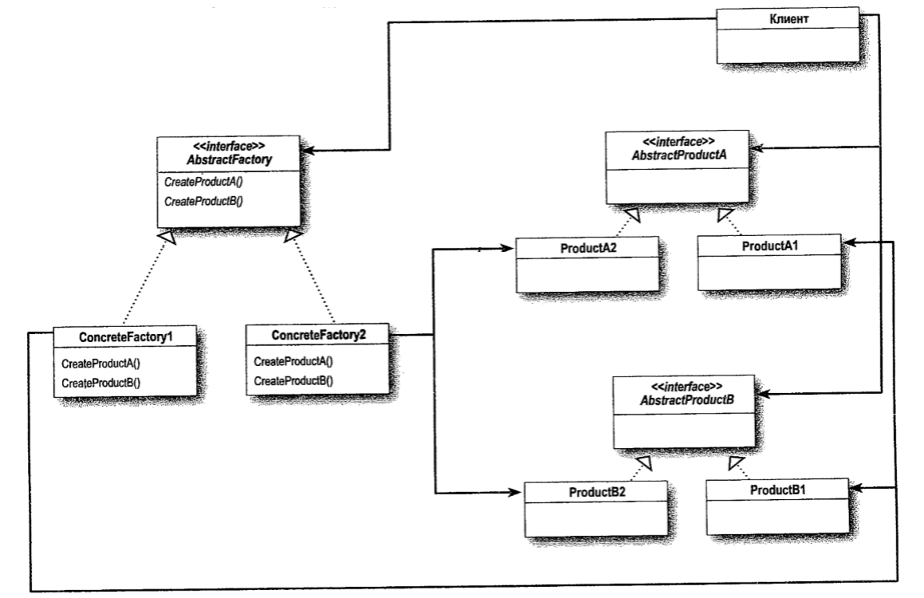
Определение паттерна Абстрактная фабрика

Slide 23
